Slide 1

Comparison of Multi-Channel EEG Based Graph Learning Methods
Dr. Mohammad B. Shamsollahi
Arshak Rezvani
#WomanLifeLiberty

Slide 2

Hello!
I am Arshak Rezvani
I am here because I love to give presentations.
You can find me at @ArshakRz

Slide 3
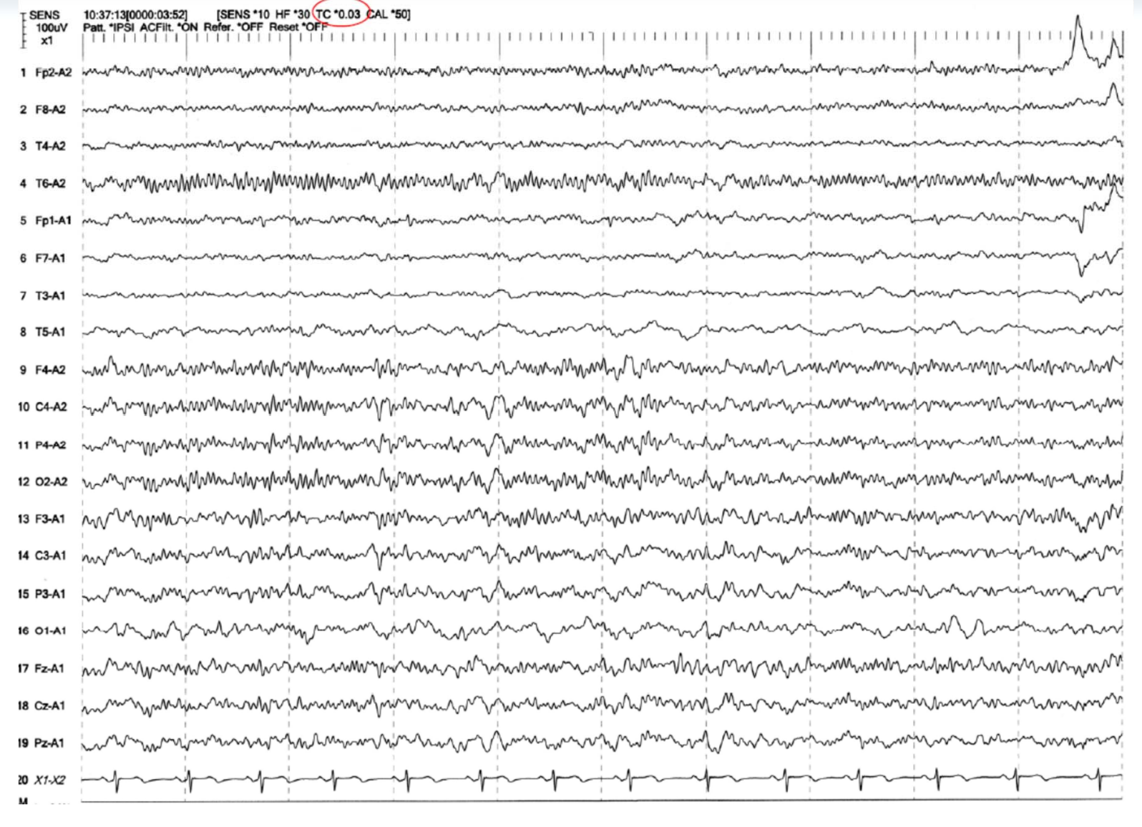
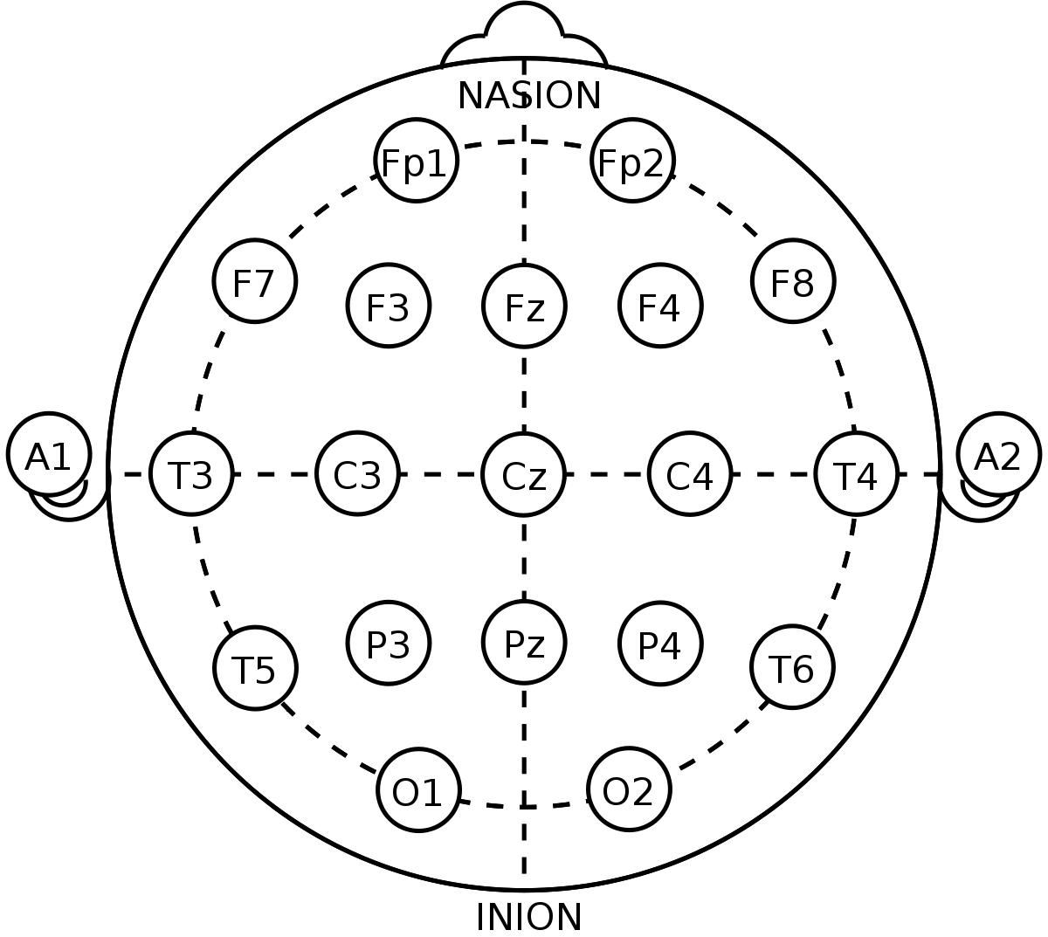
What is Multi-Channel EEG Signals? [1]
Electrode placement systems.
The 10-20 System of Electrode Placement
Electroencephalogram Time Series and Channels.
Like Noise!

Slide 4
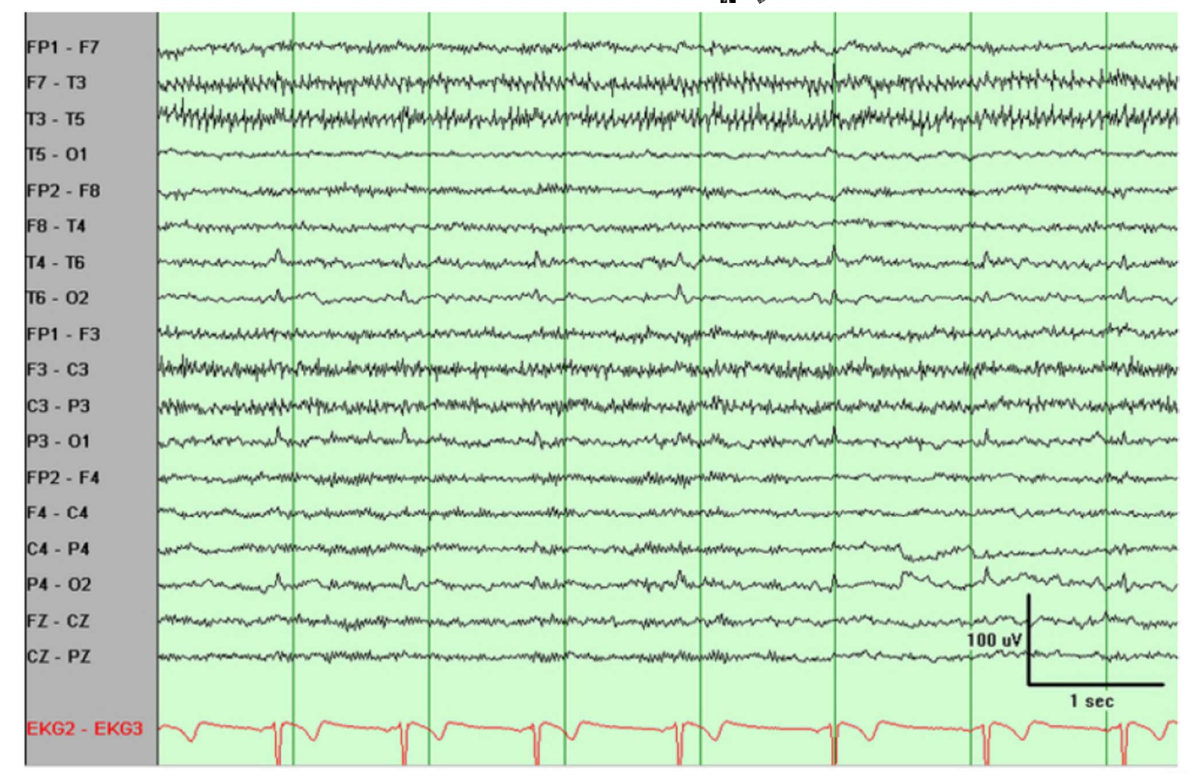
Pre-Processing [1]
Artifact Rejection
Physiologic
EMG
ECG
EOG
Blinking
Sweat
Non-Physiologic
AC electrical and electromagnetic interferences
Electrode pop and Movement

Slide 5
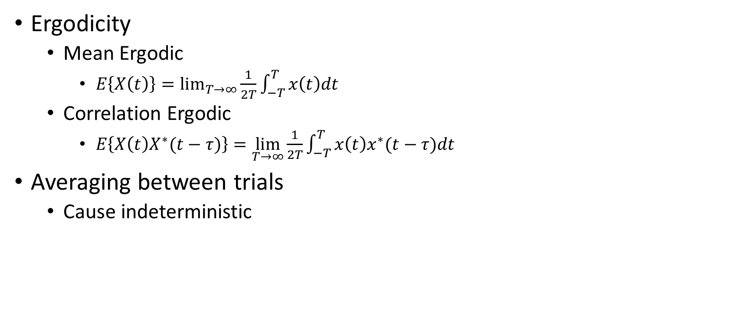
EEG as a Random Process [1]
Ergodicity
Mean Ergodic
$E\left\{X\left(t\right)\right\}=\lim_{T→∞}{\frac{1}{2T}\int_{−T}^{T}{x\left(t\right)dt}}$
Correlation Ergodic
$E\left\{X\left(t\right)X^{∗}(t−τ)\right\}=\lim_{T→∞}{\frac{1}{2T}\int_{−T}^{T}{x\left(t\right)x^{∗}(t−τ)dt}}$
Averaging between trials
Cause indeterministic

Slide 6
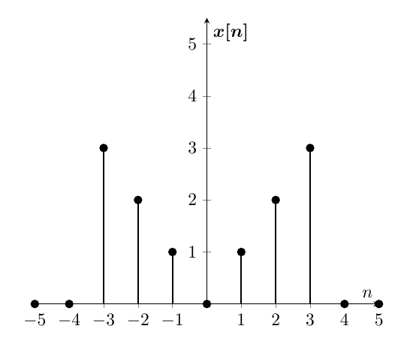
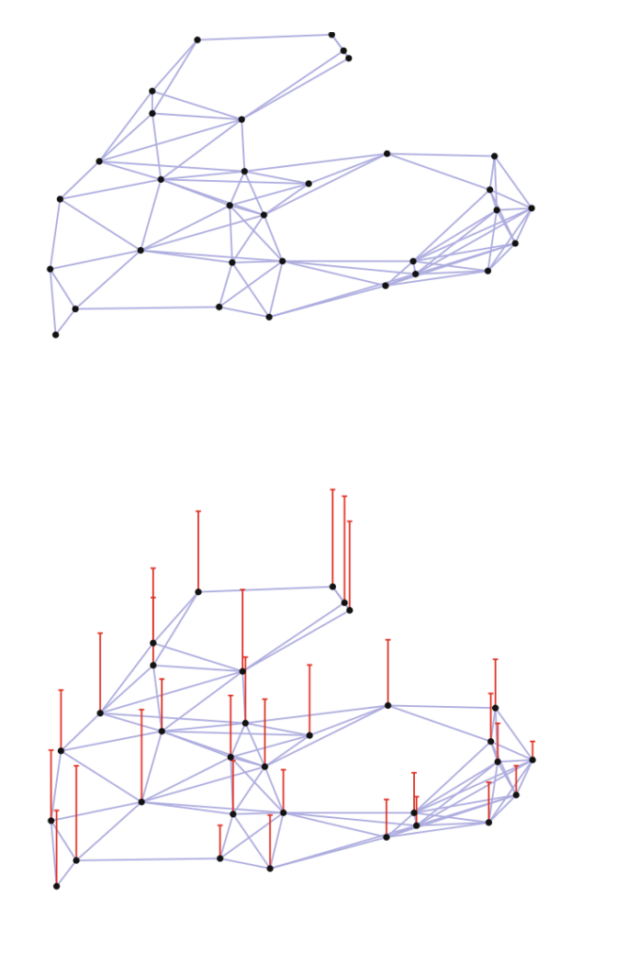
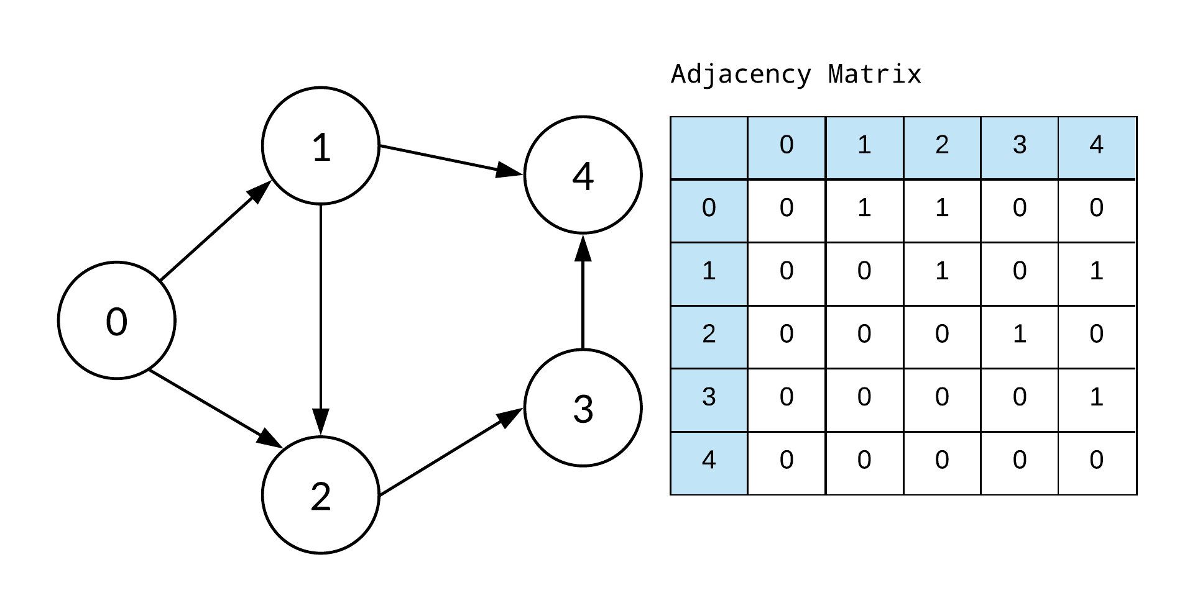
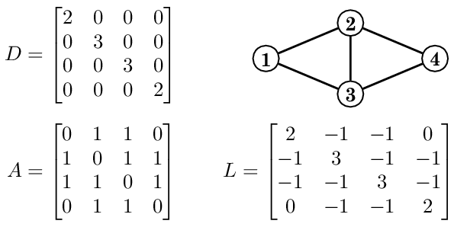
But What is a Graph Signal? [2]
A Graph!
Adjacency Matrix
Laplacian Matrix
Graph Signal
Definition and Example
It’s a Domain
Time
Frequency
Vertices
No Order!
A Vector

Slide 7
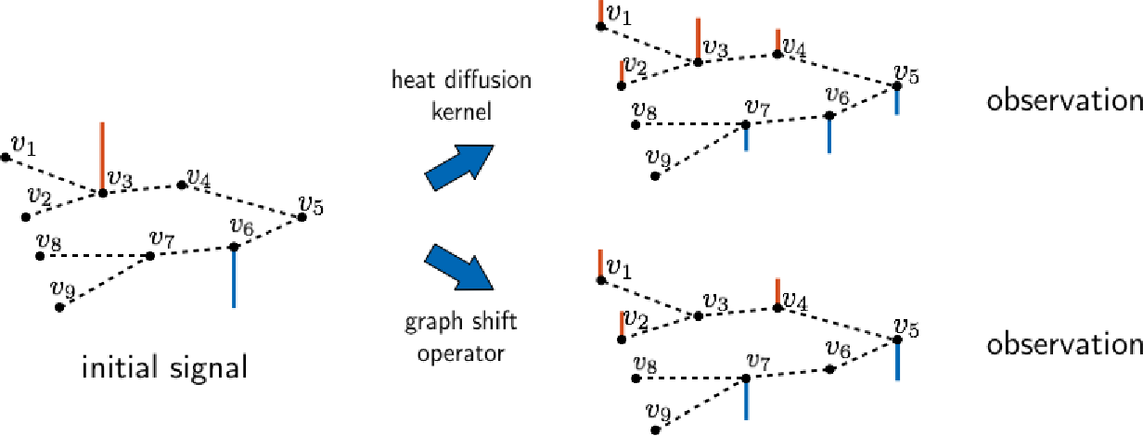
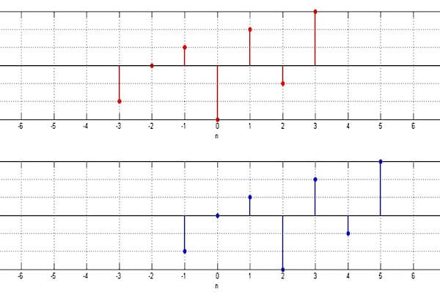
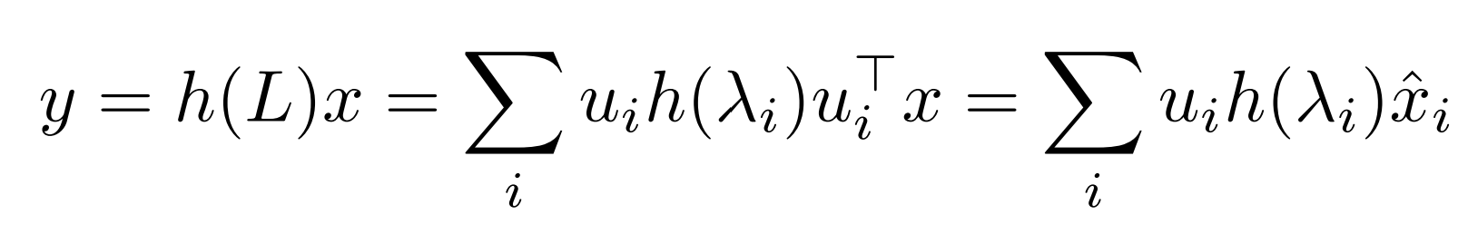
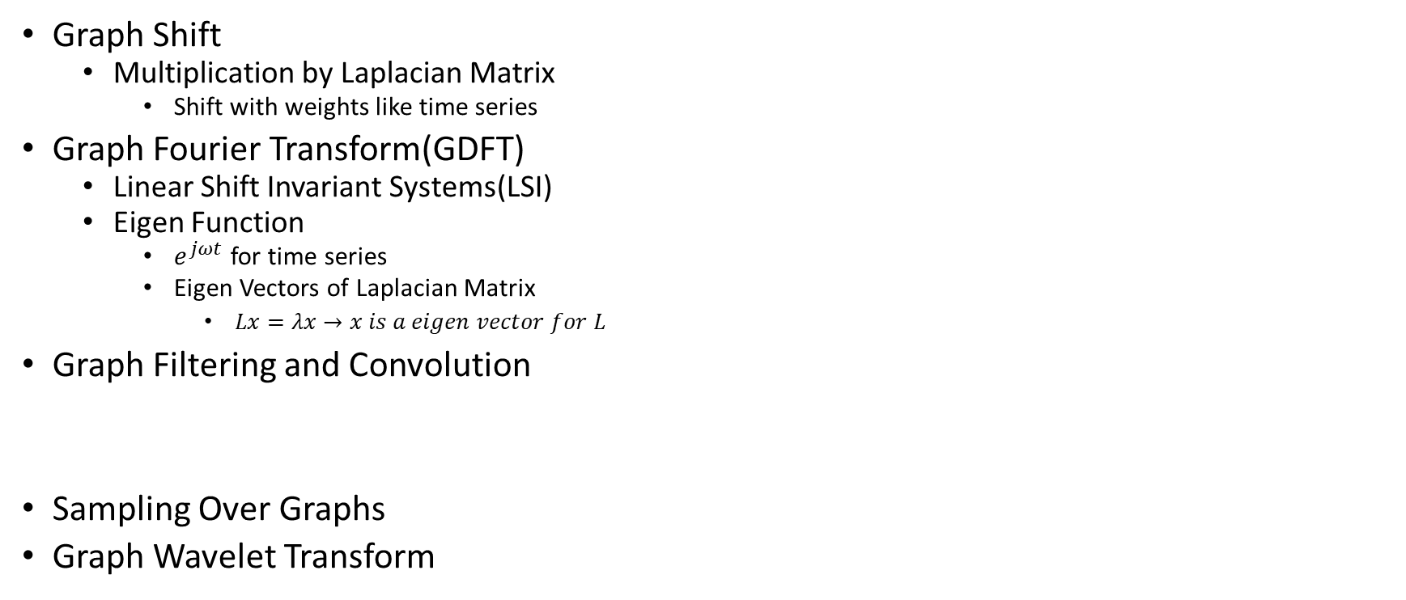
Graph Operations [2]
Graph Shift
Multiplication by Laplacian Matrix
Shift with weights like time series
Graph Fourier Transform(GDFT)
Linear Shift Invariant Systems(LSI)
Eigen Function
$e^{jωt}$ for time series
Eigen Vectors of Laplacian Matrix
$Lx=λx→x is a eigen vector for L$
Graph Filtering and Convolution
Sampling Over Graphs
Graph Wavelet Transform
Initial Signal
Shifted Signal

Slide 8
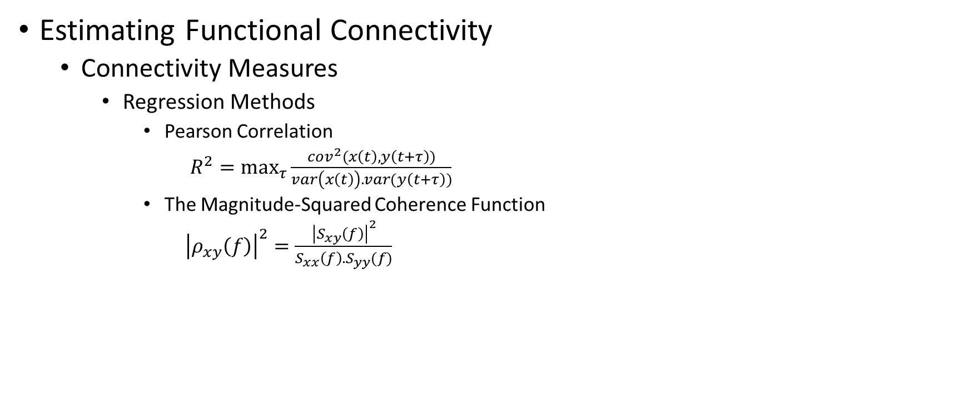
Graph Learning [3]
Estimating Functional Connectivity
Connectivity Measures
Regression Methods
Pearson Correlation
$R^{2}=\max_{τ}{\frac{cov^{2}(x\left(t\right),y\left(t+τ\right))}{var\left(x\left(t\right)\right).var(y\left(t+τ\right))}}$
The Magnitude-Squared Coherence Function
${\left|ρ_{xy}\left(f\right)\right|}^{2}=\frac{{\left|S_{xy}\left(f\right)\right|}^{2}}{S_{xx}\left(f\right).S_{yy}(f)}$

Slide 9
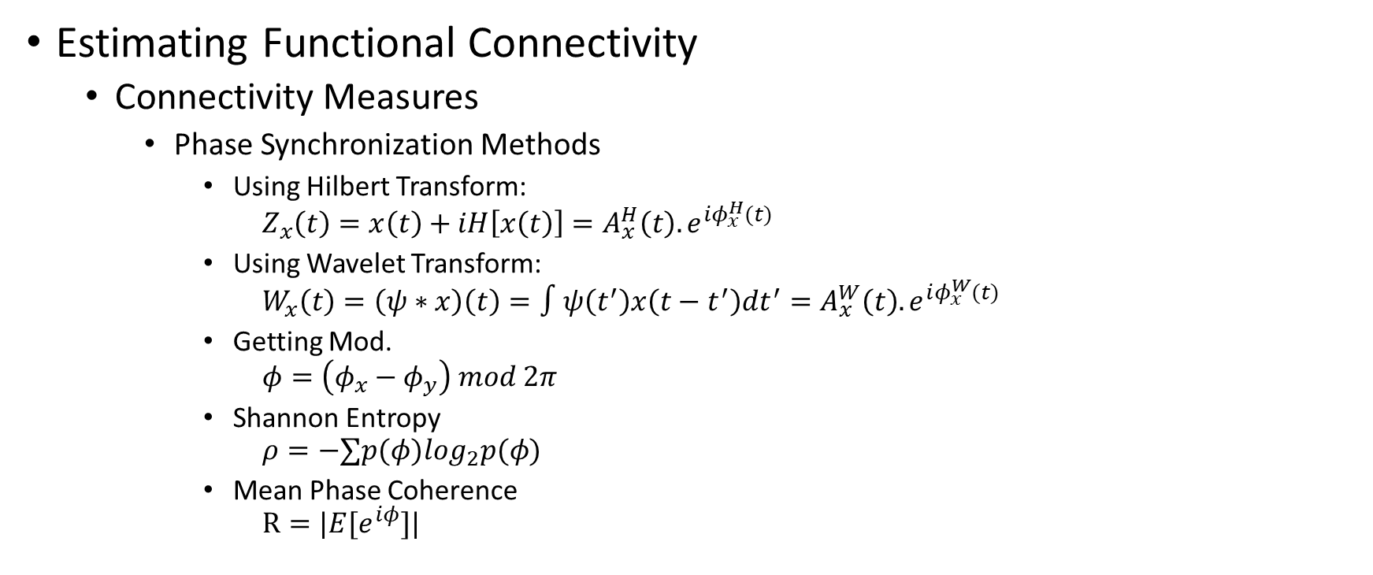
Graph Learning [3]
Estimating Functional Connectivity
Connectivity Measures
Phase Synchronization Methods
Using Hilbert Transform:
$$Z_{x}\left(t\right)=x\left(t\right)+iH\left[x\left(t\right)\right]=A_{x}^{H}\left(t\right).e^{iφ_{x}^{H}(t)}$$
Using Wavelet Transform:
$$W_{x}\left(t\right)=\left(ψ∗x\right)\left(t\right)=∫ψ\left(t^{′}\right)x\left(t−t^{′}\right)dt^{′}=A_{x}^{W}\left(t\right).e^{iφ_{x}^{W}(t)}$$
Getting Mod.
$$φ=\left(φ_{x}−φ_{y}\right) mod 2π$$
Shannon Entropy
$$ρ=−∑p(φ)log_{2}p(φ)$$
Mean Phase Coherence
$$R=|E[e^{iφ}]|$$

Slide 10
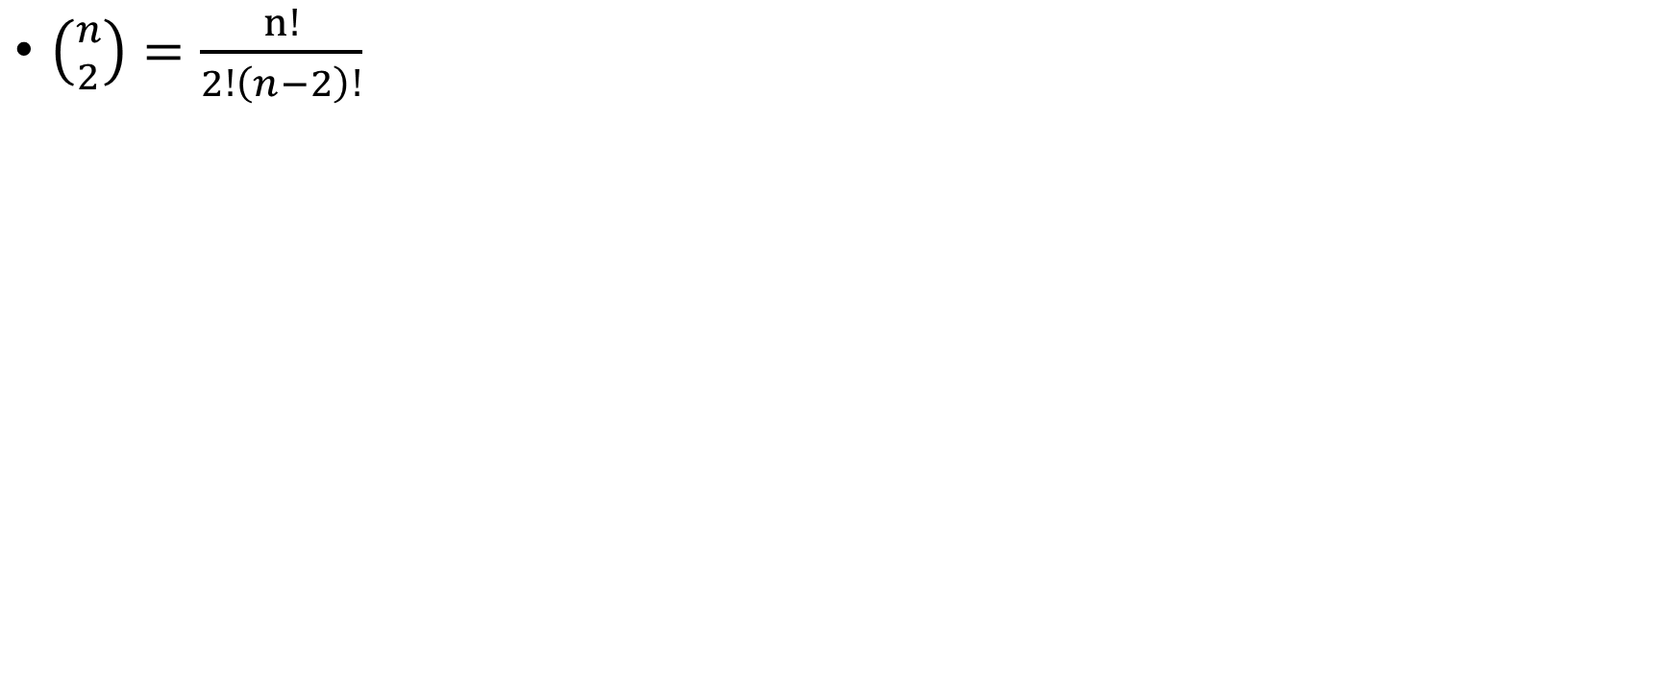
Very Complex Laplacian Matrix
$\left({n \atop 2}\right)=\frac{n!}{2!\left(n−2\right)!}$

Slide 11
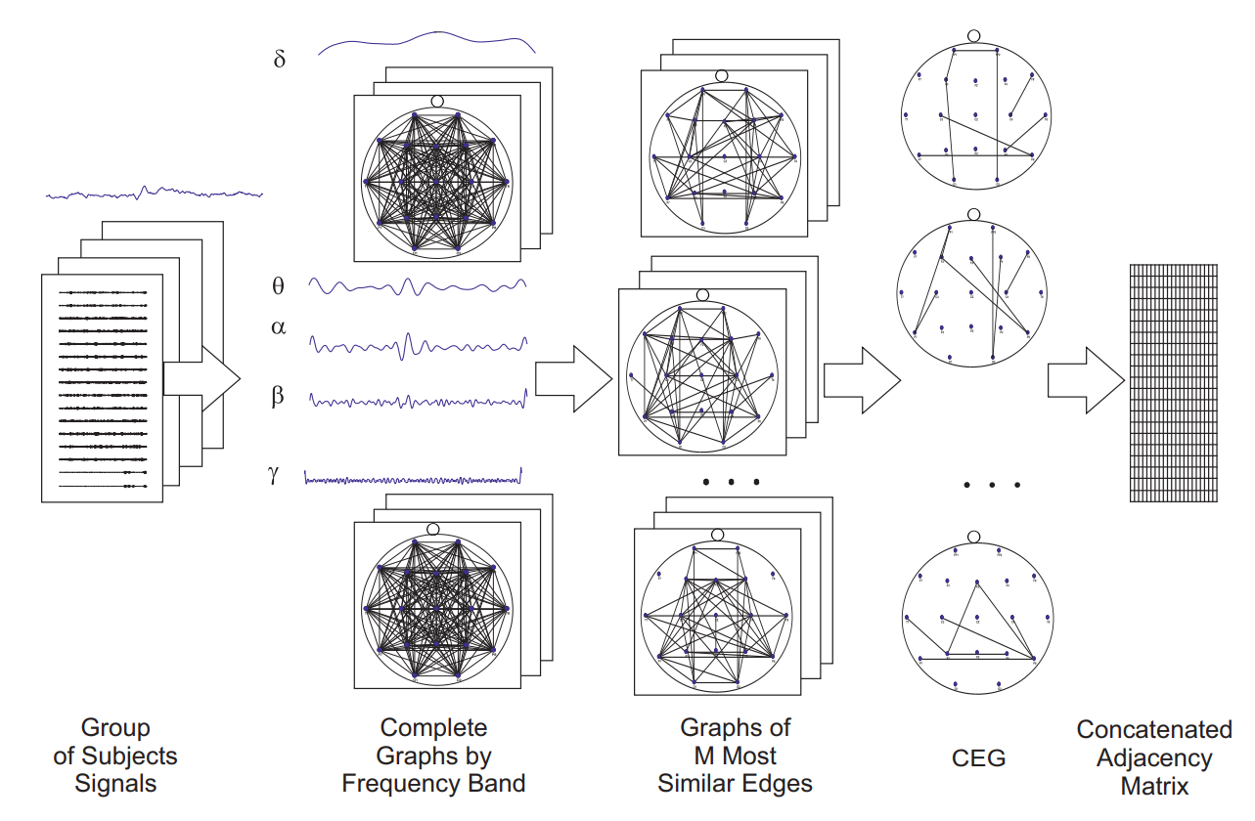
How To Make It Less Complex [4]
Fail to Represent Discriminative Patterns
Graphs vary significantly in different subjects
Common Edge Graph

Slide 12
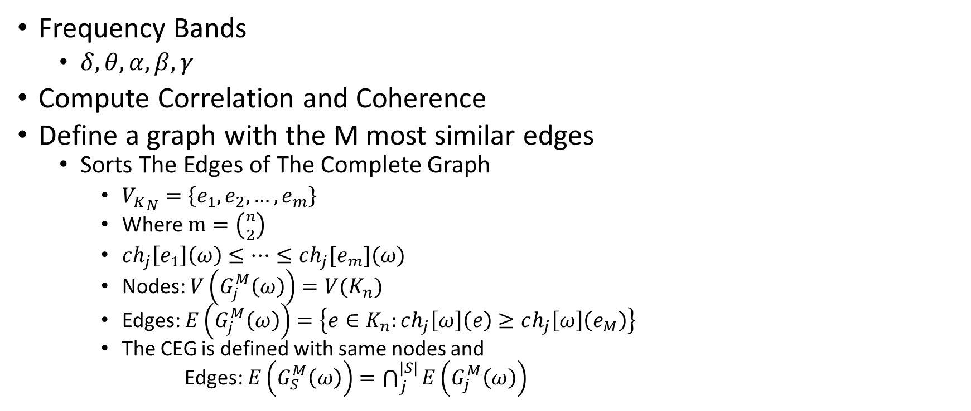
CEG(Common Edge Graph) [4]
Frequency Bands
$δ, θ, α, β,γ$
Compute Correlation and Coherence
Define a graph with the M most similar edges
Sorts The Edges of The Complete Graph
${V_{K}}_{N}=\left\{e_{1}, e_{2}, …, e_{m}\right\}$
Where $m=\left({n \atop 2}\right)$
$ch_{j}\left[e_{1}\right]\left(ω\right)≤…≤ch_{j}[e_{m}](ω)$
Nodes: $V\left(G_{j}^{M}\left(ω\right)\right)=V(K_{n})$
Edges: $E\left(G_{j}^{M}\left(ω\right)\right)=\left\{e∈K_{n}:ch_{j}\left[ω\right]\left(e\right)≥ch_{j}\left[ω\right]\left(e_{M}\right)\right\}$
The CEG is defined with same nodes and
Edges: $E\left(G_{S}^{M}\left(ω\right)\right)=\bigcap_{j}^{|S|}{E\left(G_{j}^{M}\left(ω\right)\right)}$

Slide 13
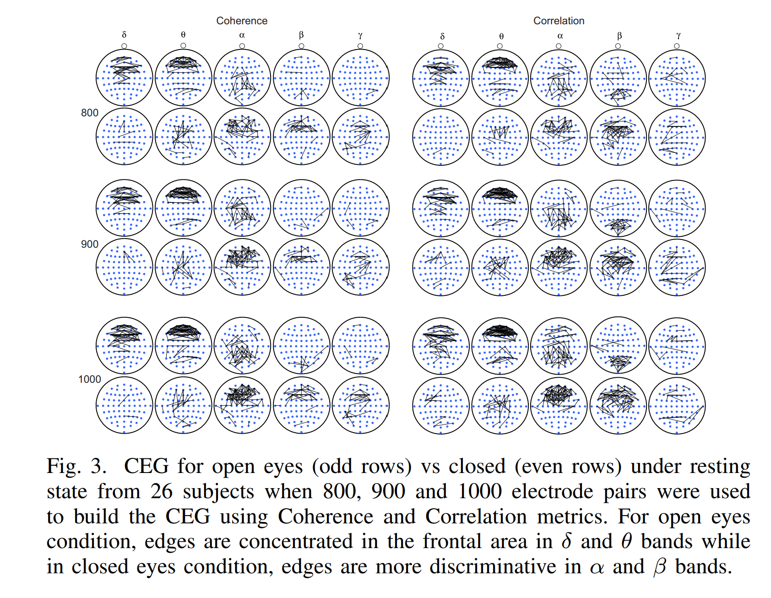
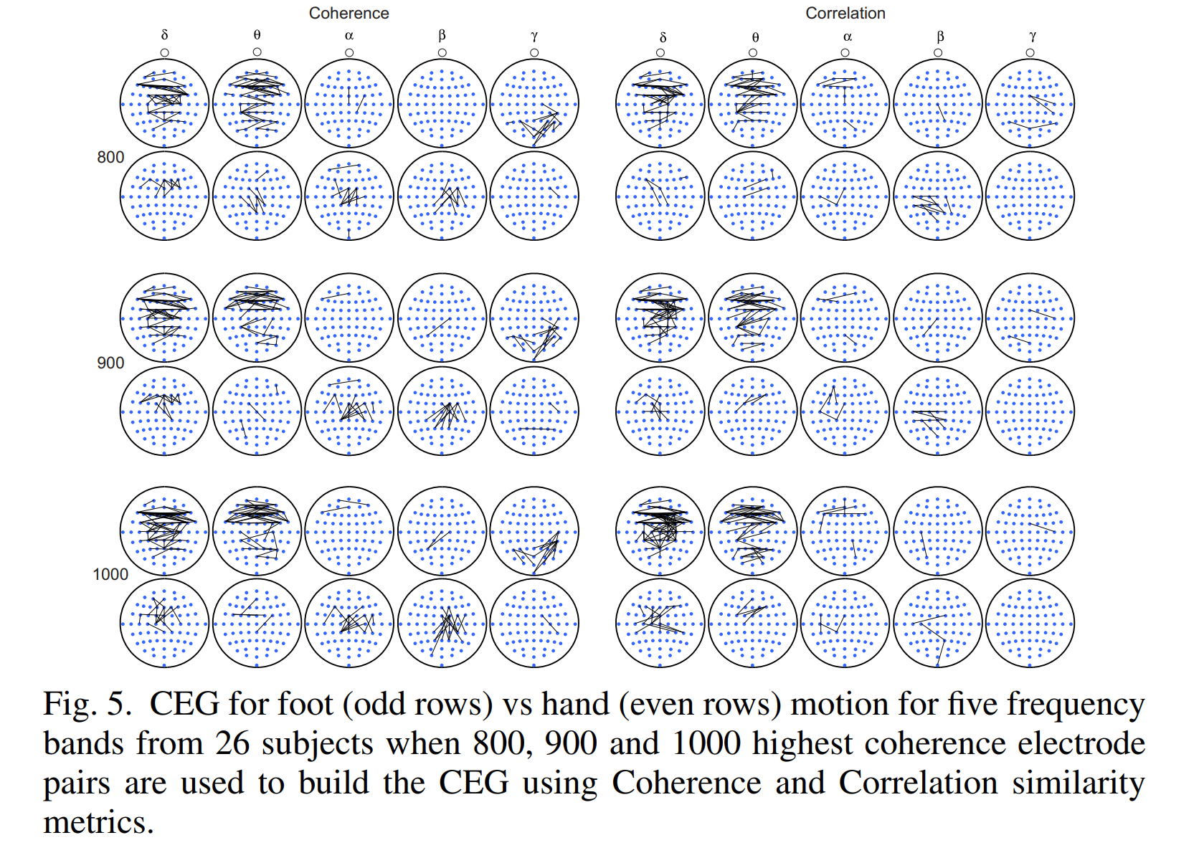
Results [4]

Slide 14
Learning Graphs From A Smooth Signal
Not Using the smoothness and time series properties
Learning the Laplacian as a whole

Slide 15
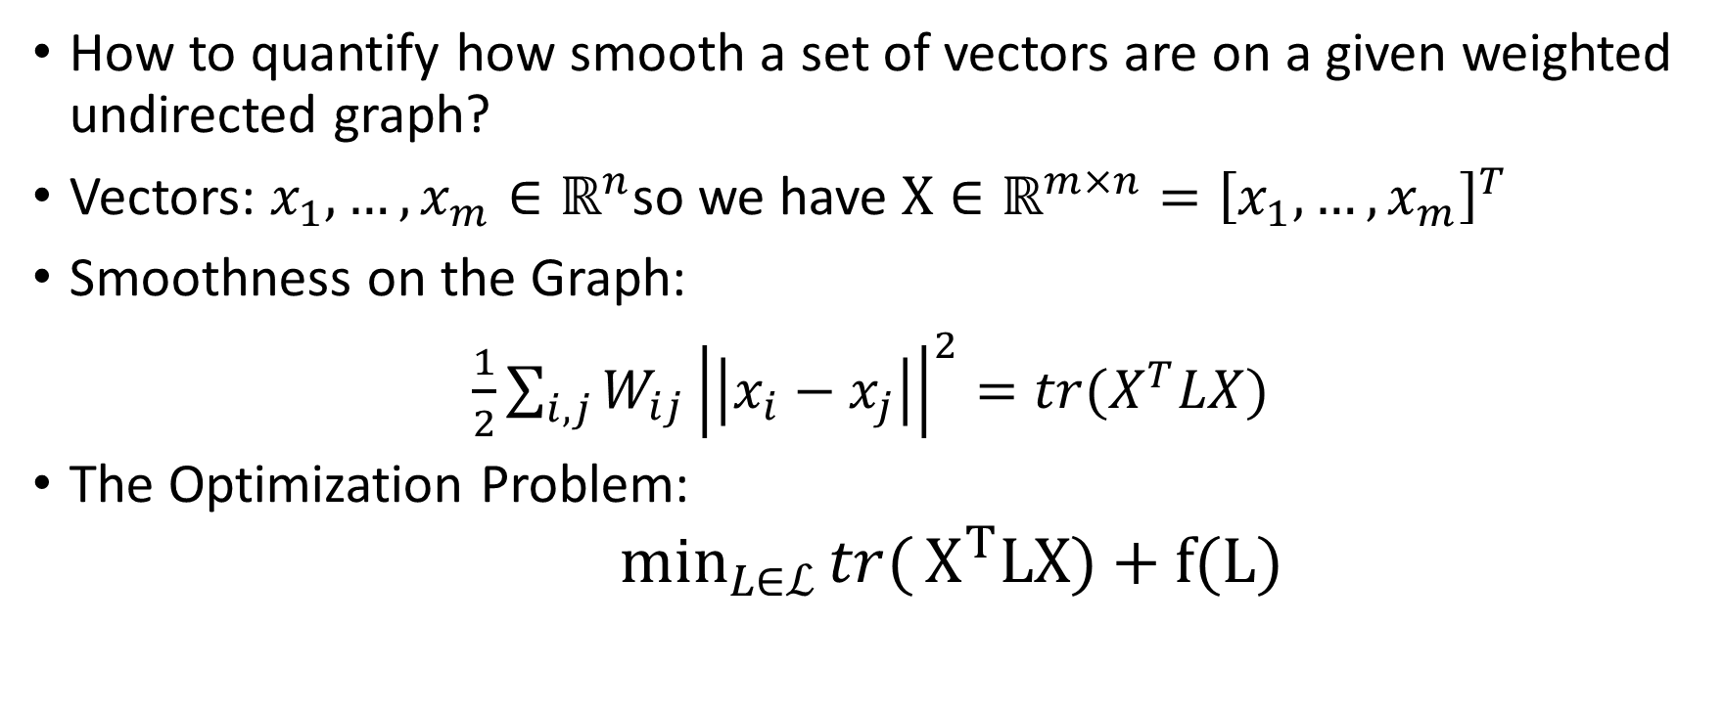
Smoothness On a Graph Definition [5]
How to quantify how smooth a set of vectors are on a given weighted undirected graph?
Vectors: $x_{1}, …, x_{m}∈ℝ^{n}$so we have $X∈ℝ^{m×n}={\left[x_{1}, …, x_{m}\right]}^{T}$
Smoothness on the Graph:
$\frac{1}{2}\sum_{i,j}{W_{ij}}{\left|\left|x_{i}−x_{j}\right|\right|}^{2}=tr(X^{T}LX)$
The Optimization Problem:
$\min_{L∈ℒ}{tr(}X^{T}LX)+f(L)$

Slide 16
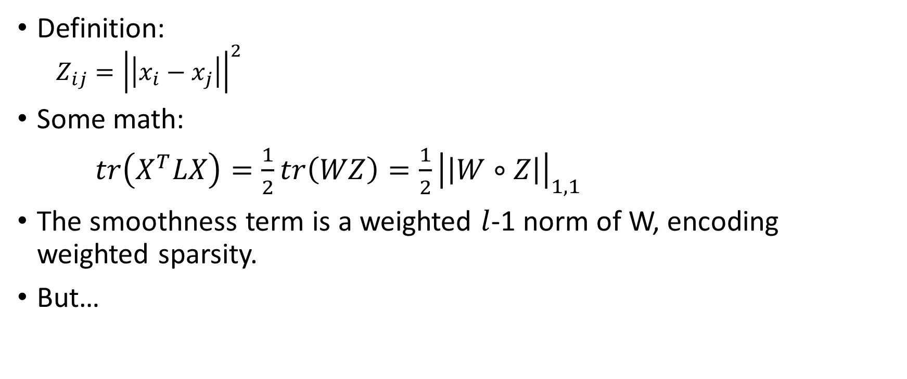
Pairwise Distance Matrix [5]
Definition:
$$Z_{ij}={\left|\left|x_{i}−x_{j}\right|\right|}^{2}$$
Some math:
$tr\left(X^{T}LX\right)=\frac{1}{2}tr\left(WZ\right)=\frac{1}{2}{\left|\left|W∘Z\right|\right|}_{1,1}$
The smoothness term is a weighted $l$-1 norm of W, encoding weighted sparsity.
But…

Slide 17
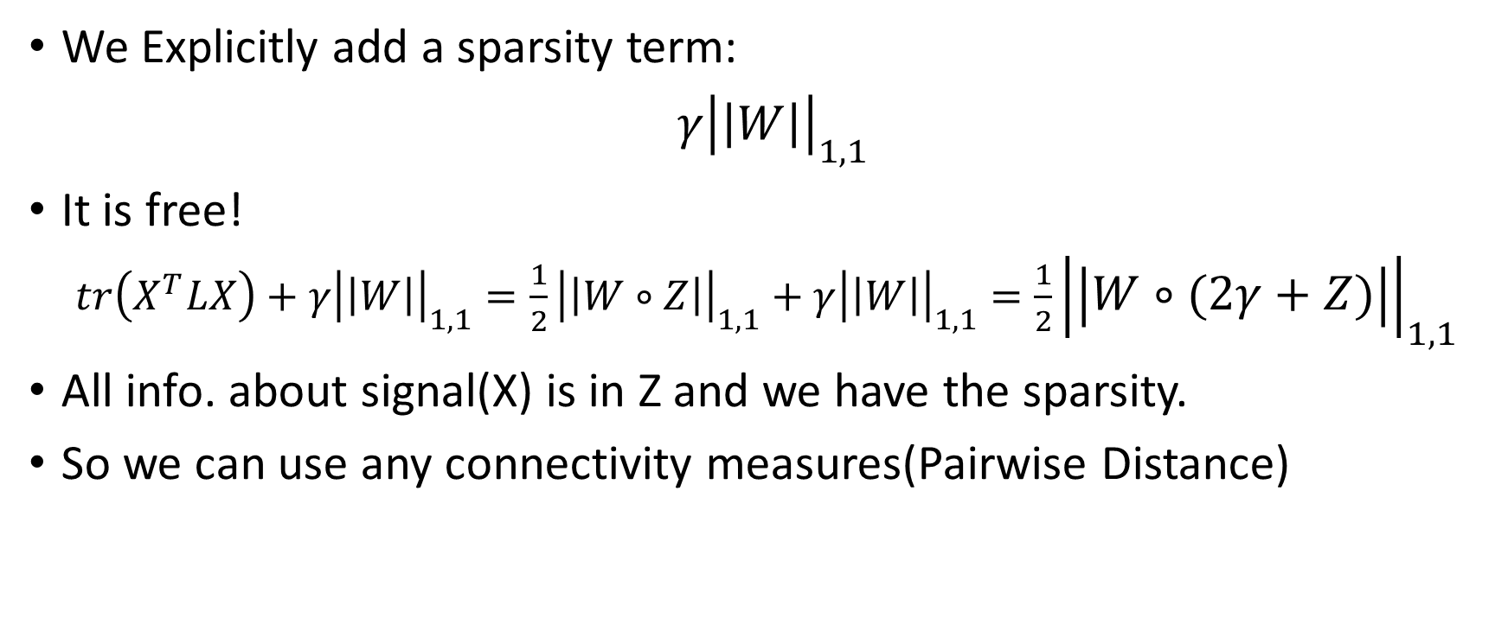
Building a Sparse Laplacian [5]
We Explicitly add a sparsity term:
$γ{\left|\left|W\right|\right|}_{1,1}$
It is free!
$tr\left(X^{T}LX\right)+γ{\left|\left|W\right|\right|}_{1,1}=\frac{1}{2}{\left|\left|W∘Z\right|\right|}_{1,1}+γ{\left|\left|W\right|\right|}_{1,1}=\frac{1}{2}{\left|\left|W∘(2γ+Z)\right|\right|}_{1,1}$
All info. about signal(X) is in Z and we have the sparsity.
So we can use any connectivity measures(Pairwise Distance)

Slide 18
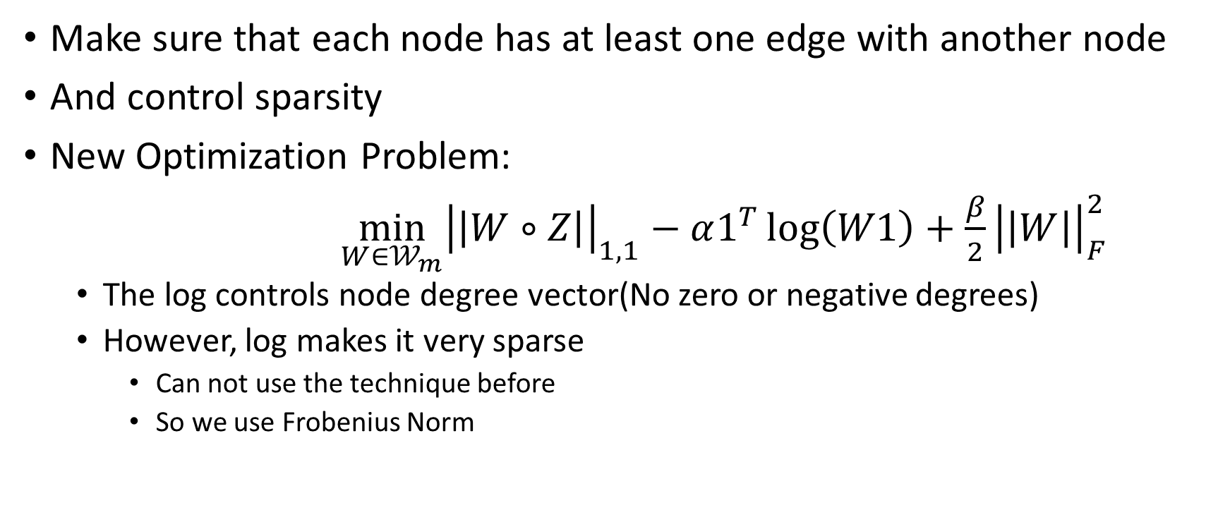
Other Constraint [5]
Make sure that each node has at least one edge with another node
And control sparsity
New Optimization Problem:
$\min_{W∈𝒲_{m}}{{\left|\left|W∘Z\right|\right|}_{1,1}}−α1^{T}\log\left(W1\right)+\frac{β}{2}{\left|\left|W\right|\right|}_{F}^{2}$
The log controls node degree vector(No zero or negative degrees)
However, log makes it very sparse
Can not use the technique before
So we use Frobenius Norm

Slide 19
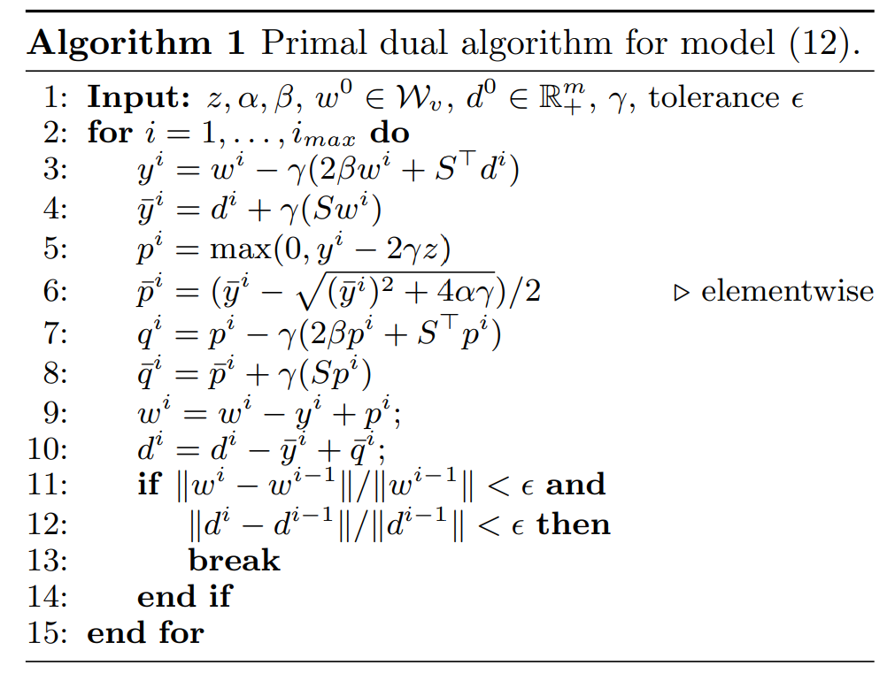
Convex Optimization [5][6]
Blah, Blah, Blah

Slide 20
Testing Criteria[8][9]
Accuracy of a Classifier
SVM
Neural Network
Decision Tree
Etc.

Slide 21
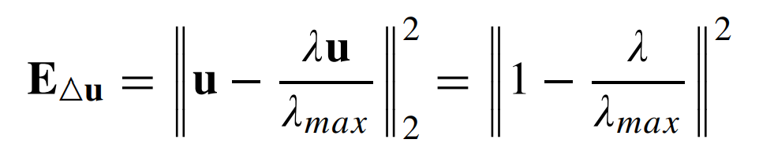
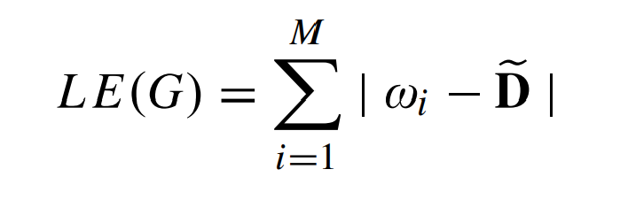
Graph Features [10]
Laplacian Matrix Elements
Two Norm Total Variation of Eigen Vector(TNTV)
Graph Laplacian Energy (GLE)
D = 2E/M, E is number of edges and M being the number of nodes of graph.
Joint Total Variation Energy (JTVE)

Slide 22
Graph Features
Much more! [7][8]
Degree: number of links connected to a node
Shortest path length: a basis for measuring integration
Global efficiency
Transitivity
Participation coefficient
Average neighbor degree
Etc.
PCA and Dimensionality Reduction!

Slide 23
References
Hajipour Sardouie, Sepideh. " EEG Signal Processing Course Notes." Sharif University of Technology(2022). [1]
Amini, Arash A. " Graph Signal Processing Course Notes." Sharif University of Technology(2021). [2]
Wendling, Fabrice, et al. "From EEG signals to brain connectivity: a model-based evaluation of interdependence measures." Journal of neuroscience methods 183.1 (2009): 9-18. [3]
López, Rafae Lemuz, et al. "Graph theory for brain connectivity characterization from EEG." 2020 10th International Symposium on Signal, Image, Video and Communications (ISIVC). IEEE, 2021. [4]
Kalofolias, Vassilis. "How to learn a graph from smooth signals." Artificial Intelligence and Statistics. PMLR, 2016. [5]
Kalofolias, Vassilis, and Nathanaël Perraudin. "Large scale graph learning from smooth signals." arXiv preprint arXiv:1710.05654 (2017). [6]
Rubinov, Mikail, and Olaf Sporns. "Complex network measures of brain connectivity: uses and interpretations." Neuroimage 52.3 (2010): 1059-1069. [7]
Sen, Bhaskar, et al. "Classification of obsessive-compulsive disorder from resting-state fMRI." 2016 38th Annual International Conference of the IEEE Engineering in Medicine and Biology Society (EMBC). IEEE, 2016. [8]
Saboksayr, Seyed Saman, Gonzalo Mateos, and Mujdat Cetin. "EEG-based emotion classification using graph signal processing." ICASSP 2021-2021 IEEE International Conference on Acoustics, Speech and Signal Processing (ICASSP). IEEE, 2021. [9]
Mathur, Priyanka, and Vijay Kumar Chakka. "Graph Signal Processing Based Cross-Subject Mental Task Classification Using Multi-Channel EEG Signals." IEEE Sensors Journal 22.8 (2022): 7971-7978. [10]

Slide 24
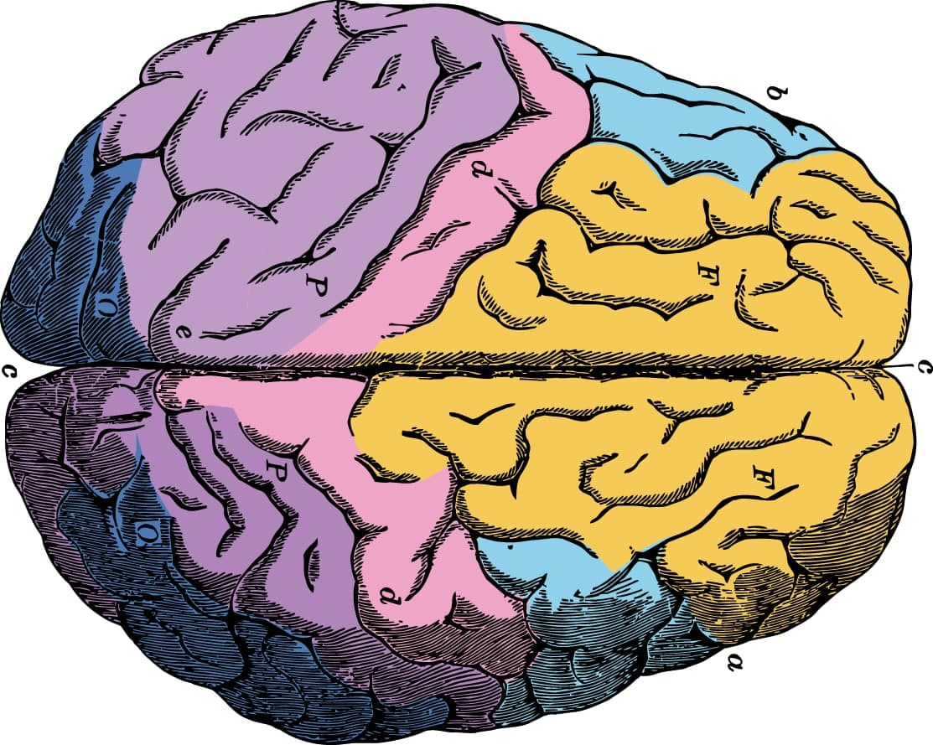
Thanks for Your Attention!

